Slide 1

Optimizing MNIST Classification Using CUDA
Exploring GPU-accelerated deep learning techniques for MNIST digit recognition.
By: Saad Nadeem, Mustafa Iqbal, Hassaan Anwar
Instructor: Imran Ashraf
Course: High Performance Computing Using GPUs

Slide 2
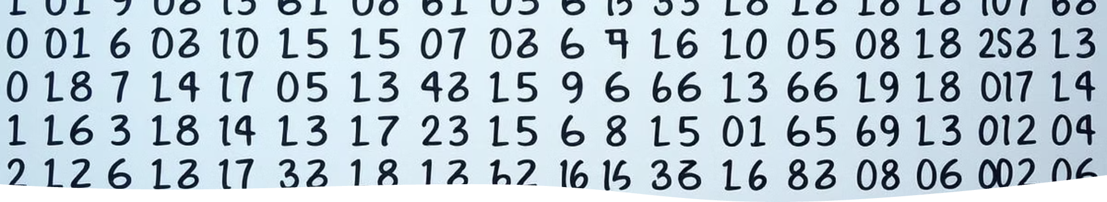
Project Overview & Dataset
Project Goal
Dataset Details
Speed up MNIST classification using neural networks on GPUs.
60k training and 10k testing 28×28 grayscale digit images.
Baseline Setup
Evaluation Metrics
Sequential CPU C implementation for performance comparison.
Execution time
Accuracy
GPU utilization

Slide 3
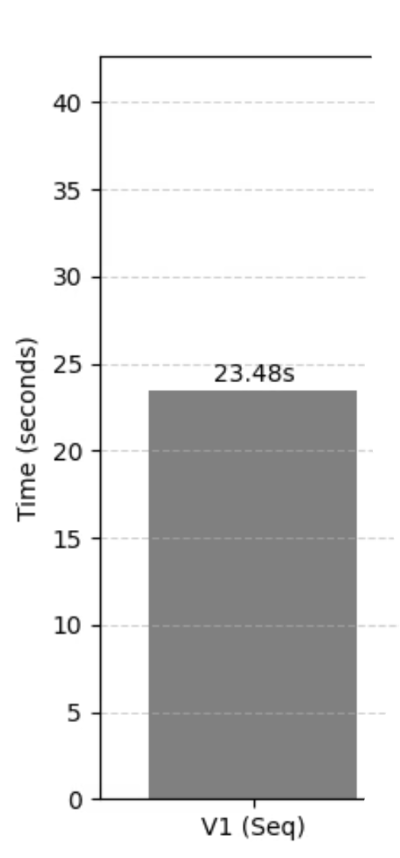



V1 - Sequential CPU Baseline
Network Structure
Performance
Single hidden layer with 128 neurons using ReLU and Softmax.
Training time: 23.48s per sample without batching.
Hotspots
Forward pass dominates runtime (~66%), backward pass( ~32%.)
All math done via nested loops

Slide 4
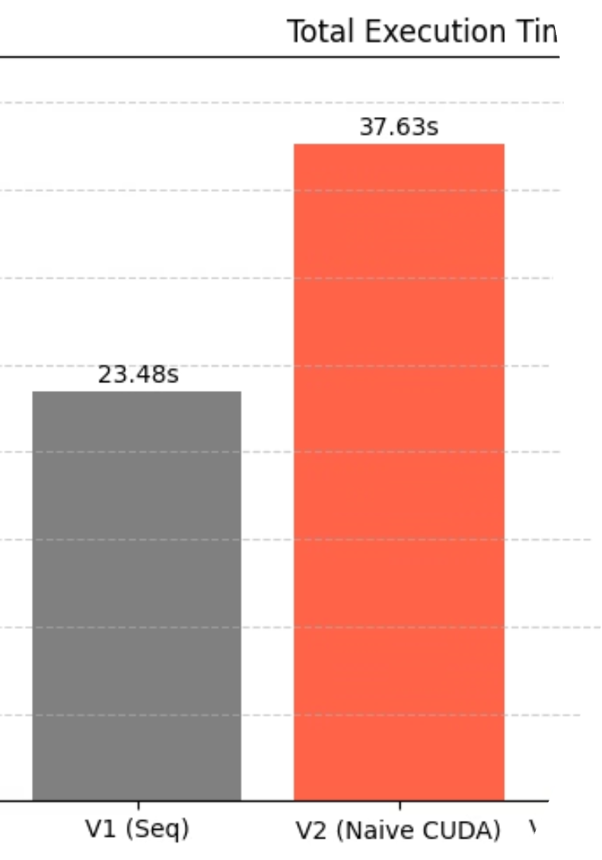
V2 - Naive CUDA Implementation
Parallelization Approach
Issues Identified
Matrix ops, activations, gradients parallelized using CUDA kernels.
Excessive host-device transfers
Per-sample training
No shared memory or memory coalescing
Kernels: matrixMul, relu, softmax, gradients, updateParams
Worse performance (37.63s) than CPU baseline
Speedup: 0.62× (slower than CPU)

Slide 5
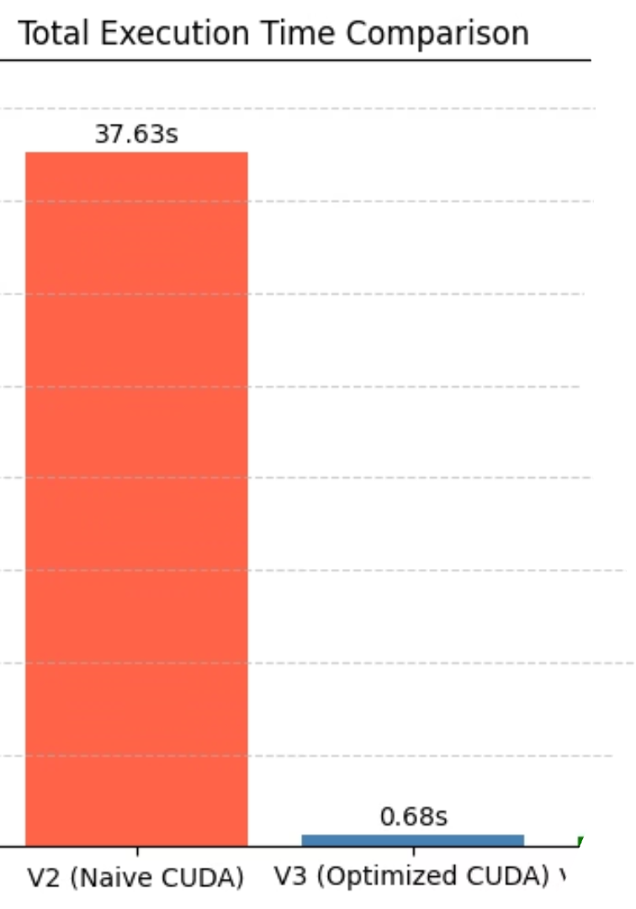
V3 - Optimized CUDA with Batching
Key Optimizations
Double buffering, asynchronous parameter updates
Memory-mapped I/O, kernel fusion of FC + ReLU
Static gradient buffers, pinned memory, aligned allocations
Batch Size Trade-offs
Batch size 32 balances speed and accuracy.
Execution time: 0.675s; Speedup: 34.79×; Accuracy: 91.25%

Slide 6

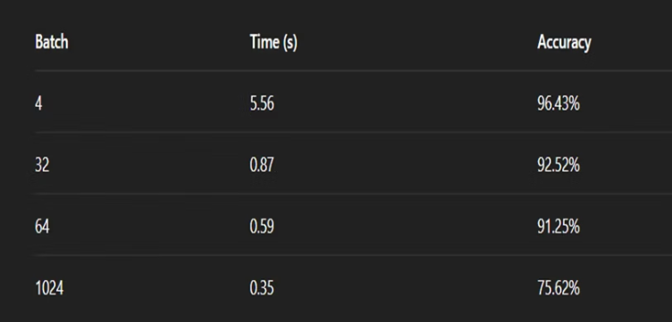
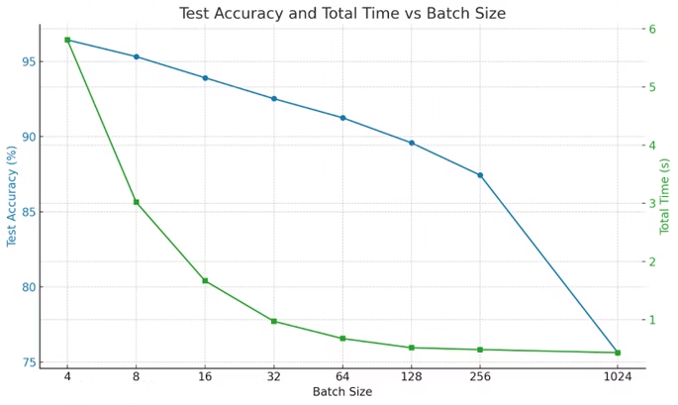
Batch Size Impact on Performance
Smaller batches yield higher accuracy but slower speed. Larger batches run faster with slight accuracy drop.
Optimal batch size roughly 32–64 for balanced outcomes.

Slide 7

V4 - Tensor Cores with WMMA
Implementation
Full rewrite of matrix operations in FP16 using WMMA and __half precision.
Challenges
Significant accuracy loss due to low precision
No native FP32 support limits stability
Loss scaling and mixed precision needed
Conclusion: Fast but impractical for accuracy-sensitive MNIST task.

Slide 8
V5 - OpenACC GPU Porting
Implementation Details
Strengths & Limitations
Forward pass and softmax ported to GPU using OpenACC pragmas.
Easy to write and maintain
Speedup limited to forward pass only
#pragma acc parallel loop, acc_malloc, acc_memcpy_to_device
Backpropagation remains CPU-bound
No batching or kernel fusion
Explicit data management functions

Slide 9
V6 - cuBLAS with TF32 Tensor Cores
Key Features
Performance Metrics
Batch-aware cublasGemmEx calls with TF32 precision
Execution time: 0.560s
Merged addBiasWithOptionalReLU kernel
41.07× speedup vs baseline
Work and data transfer overlap using custom CUDA streams
Accuracy: 91.30%

Slide 10
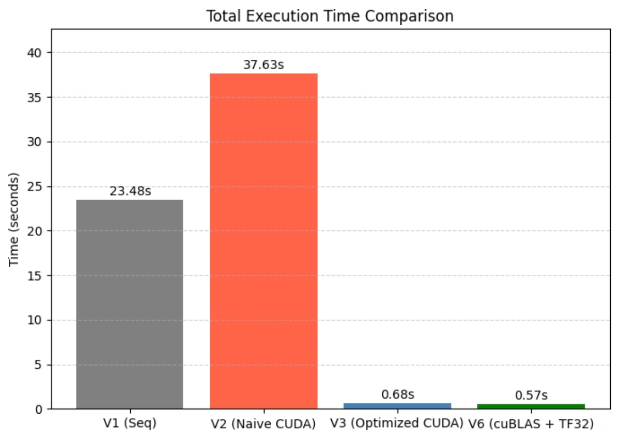

Slide 11

Conclusion & Key Takeaways
Insights
Key Bottlenecks Identified:
CUDA acceleration drastically reduces training times.
Per-sample training (V1–V2)
Batch size tuning optimizes speed-accuracy trade-offs.
Excessive cudaMemcpy, cudaMalloc
cuBLAS with TF32 offers a scalable high-performance solution.
What Worked:
Manual WMMA usage demands careful precision management.
Batching (huge impact)
Kernel fusion
OpenACC eases GPU porting but limits end-to-end speedup.
Double buffering
Tensor Cores (only with precision care)

Slide 12


